Slide 1
Interrupts in Thread
An interrupt is an indication to a thread that it should stop what it is doing and do something else.
It's up to the programmer to decide exactly how a thread responds to an interrupt, but it is very common for the thread to terminate.
A thread sends an interrupt by invoking interrupt() on the Thread object for the thread to be interrupted.
interrupt()
T2
T1
T3

Slide 2
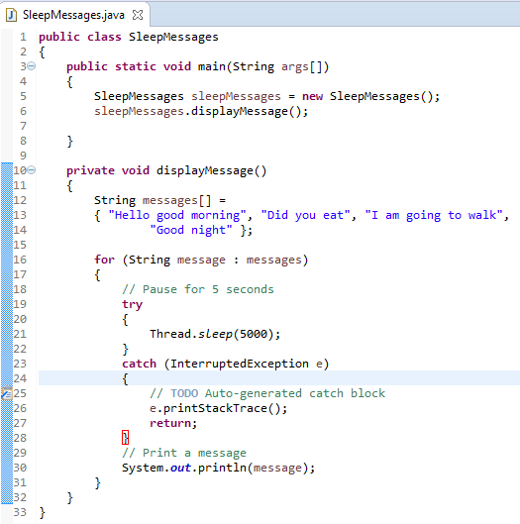
Interrupts in Thread
How does a thread support its own interruption?
This depends on what it's currently doing. If the thread is frequently invoking methods that throw InterruptedException, it simply returns from the run method after it catches that exception
Many methods that throw InterruptedException, such as sleep, are designed to cancel their current operation and return immediately when an interrupt is received.

Slide 3
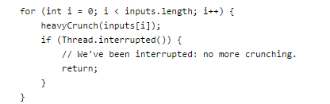

Interrupts in Thread
What if a thread goes a long time without invoking a method that throws InterruptedException? Then it must periodically invoke Thread.interrupted(), which returns true if an interrupt has been received.
In this simple example, the code simply tests for the interrupt and exits the thread if one has been received.
In more complex applications, it might make more sense to throw an InterruptedException. This allows interrupt handling code to be centralized in a catch clause.

Slide 4
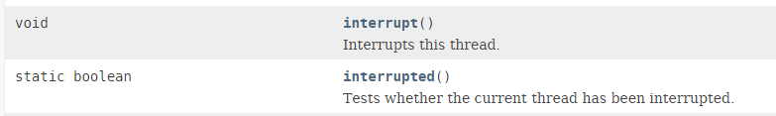
Interrupts in Thread
The Interrupt Status Flag
The interrupt mechanism is implemented using an internal flag known as the interrupt status. Invoking Thread.interrupt() sets this flag. When a thread checks for an interrupt by invoking the static method Thread.interrupted(), interrupt status is cleared. The non-static isInterrupted() method, which is used by one thread to query the interrupt status of another, does not change the interrupt status flag.
By convention, any method that exits by throwing an InterruptedException clears interrupt status when it does so. However, it's always possible that interrupt status will immediately be set again, by another thread invoking interrupt().

